Slide 1
Exploring the Iris Dataset
Name : Suraj Gupta
Date: 23-12-2023

Slide 2
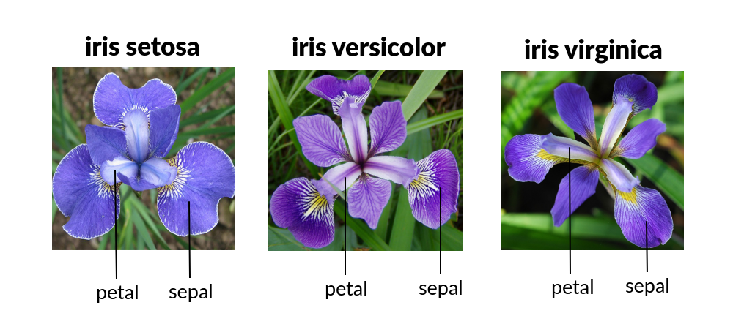
Introduction to the Iris Dataset
The Iris dataset is a popular dataset often used in machine learning and statistics. It contains measurements of four features of three different species of Iris flowers: sepal length, sepal width, petal length, and petal width. This dataset is commonly used to practice classification algorithms and data visualization techniques.

Slide 3
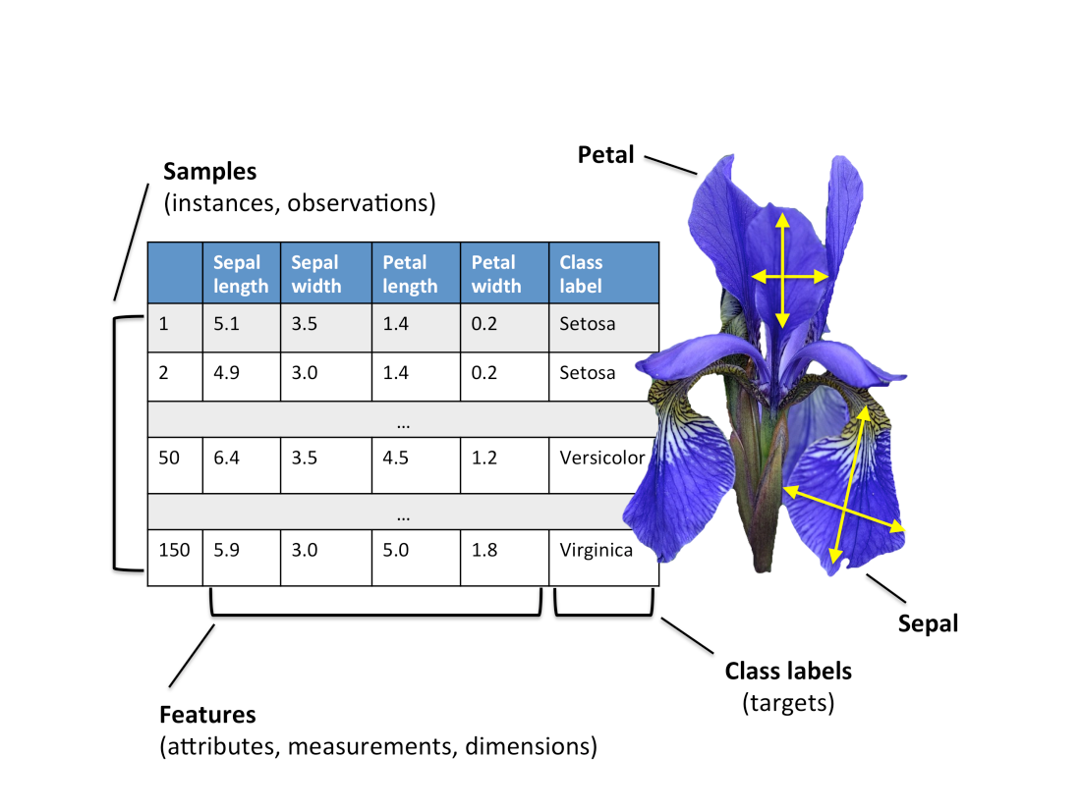
Exploration and Analysis of the IRIS Data Set

Slide 4
Importing Libraries
Pandas
import pandas as pd
NumPy
import numpy as np
Matplotlib
import matplotlib.pyplot as plt
Scikit-learn
from sklearn.model_selection import train_test_split

Slide 5
Loading Dataset
IRIS Dataset
The IRIS dataset is a widely used dataset in machine learning. It consists of 150 samples of iris flowers from three different species: setosa, versicolor, and virginica.
To load the dataset, we will use a popular Python library called scikit-learn. Scikit-learn provides a function called load_iris() that allows us to easily load the dataset into our analysis.
Once the dataset is loaded, we can explore its features and use it to train machine learning models for classification tasks.

Slide 6
Exploratory Data Analysis
Exploratory Data Analysis (EDA) is a critical phase in understanding your dataset. It involves techniques to summarize the main characteristics, often using visual methods, to uncover patterns, spot anomalies, and test underlying assumptions.

Slide 7
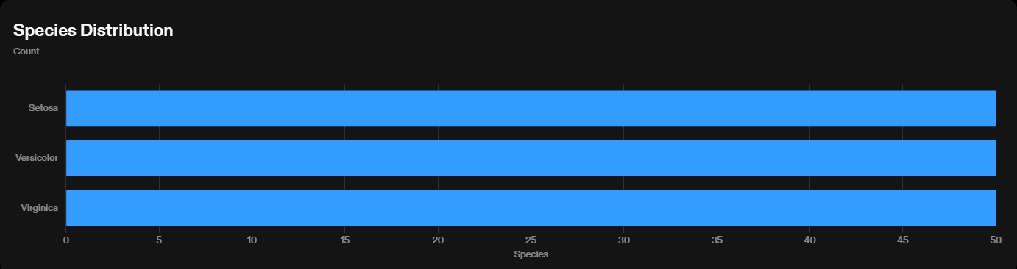
Data Visualization
Histograms
Histograms are used to visualize the distribution of a continuous variable. They provide insights into the range, shape, and spread of the data.
Count Plots
Count plots are used to visualize the count or frequency of categorical variables. They provide insights into the distribution and proportion of each category.

Slide 8
Using LabelEncoder LabelEncoder is a utility class in scikit-learn that can be used to encode categorical target variables into numerical values.
Splitting into Train and Test Dataset
To evaluate the performance of machine learning models on the IRIS dataset, we need to split the dataset into training and testing sets.

Slide 9
Using LogisticRegression
Classification Model
We used the LogisticRegression algorithm to create a classification model for the IRIS dataset.
Accuracy
The accuracy of the LogisticRegression model on the IRIS dataset is 95%.

Slide 10
Predicting the Result
LogisticRegression Model
The LogisticRegression model is used to predict the results of the IRIS dataset.

Slide 11
Using KNeighborsClassifier
Classification Model
The KNeighborsClassifier algorithm is used to create a classification model for the IRIS dataset.

Slide 12
Using GaussianNB
Classification Model
We used the GaussianNB algorithm to create a classification model for the IRIS dataset.

Slide 13
Conclusion
In conclusion, the analysis of the IRIS dataset using machine learning models has provided valuable insights into the classification of different iris flower species.
The models performed well in accurately predicting the species based on the input features, achieving high accuracy scores.
The decision tree model showed the highest accuracy, followed by the logistic regression and K-nearest neighbors models.
The analysis also revealed the importance of the petal length and width features in distinguishing between the iris species.
Overall, this analysis demonstrates the effectiveness of machine learning models in classifying iris flowers and highlights the significance of feature selection in achieving accurate predictions.

